Slide 1
GeoCollaboration
On Wildlife Issues

Slide 2
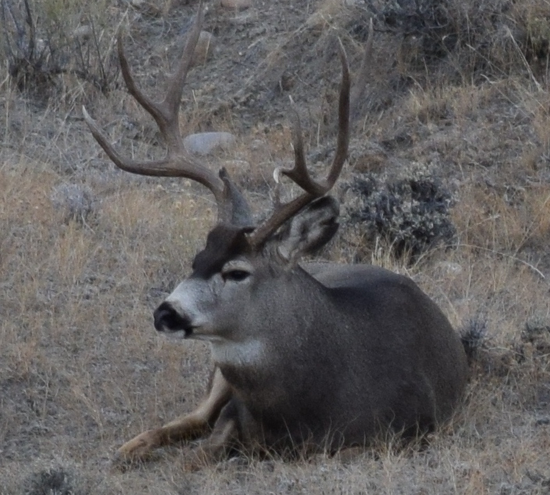
Howdy!
Karen Rogers
Wyoming Game and Fish Department

Slide 3
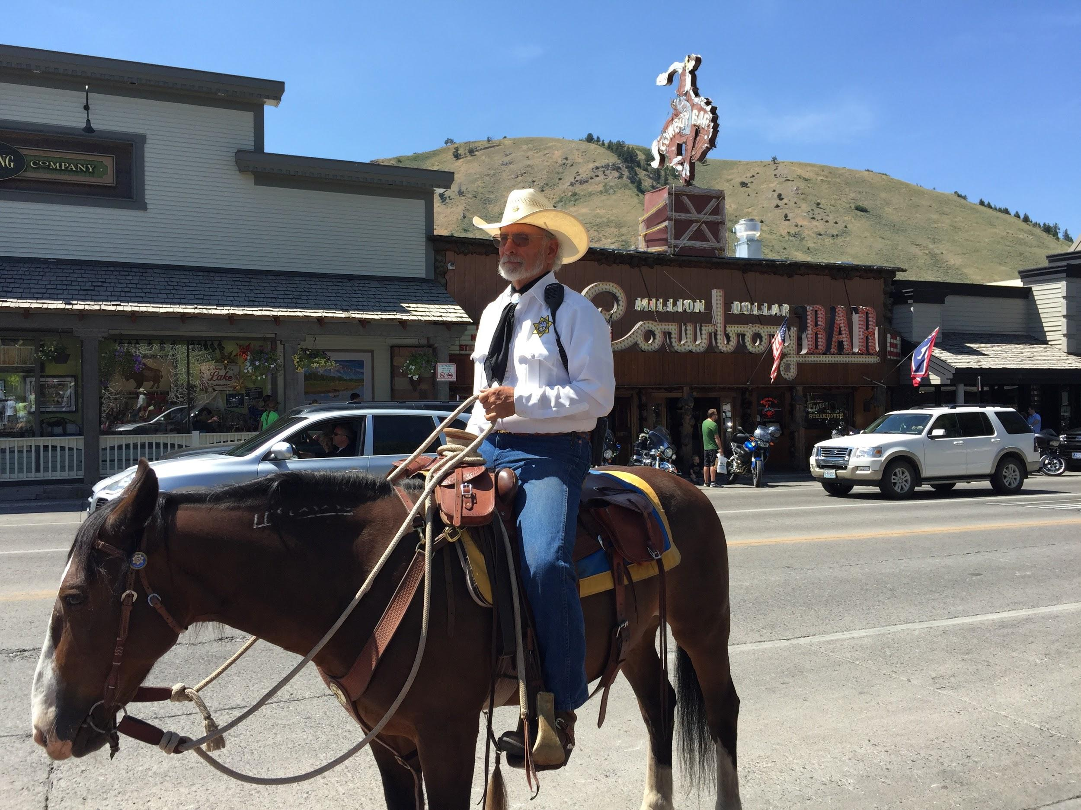

Slide 4
$303,588,073
Total contribution to Wyoming’s economy from hunting per year

Slide 5
Sublette Mule Deer Migration Corridor
1
Where DO the deer roam?

Slide 6
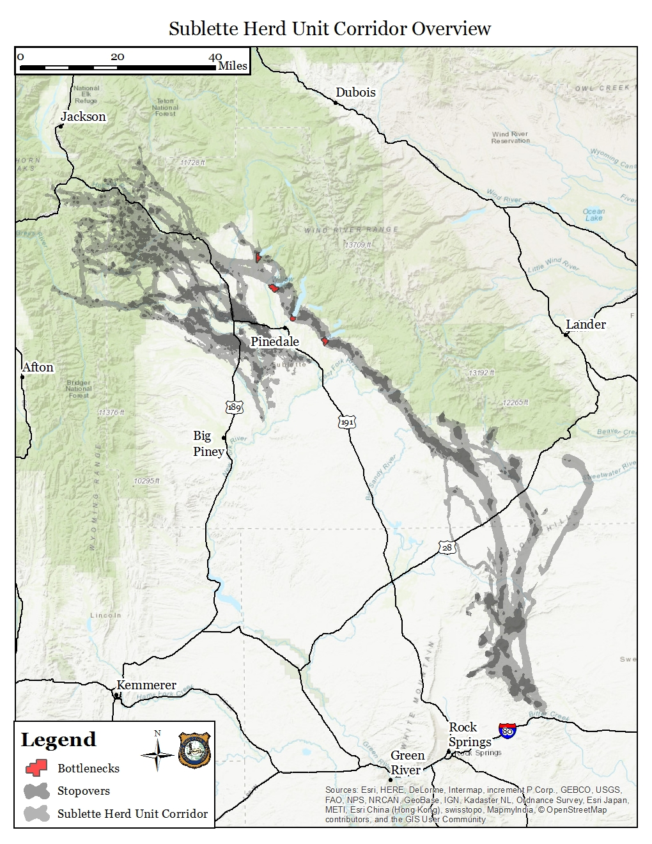

Slide 7
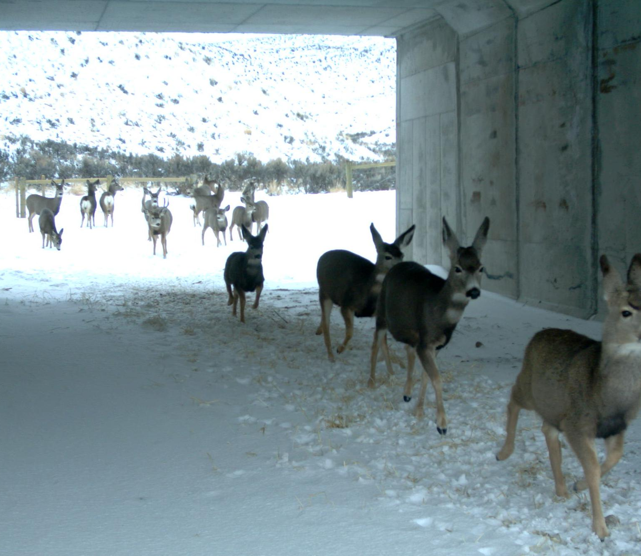
Red Desert to Hoback migration
Longest mule deer migration corridor
Second longest migration for big game in North America

Slide 8
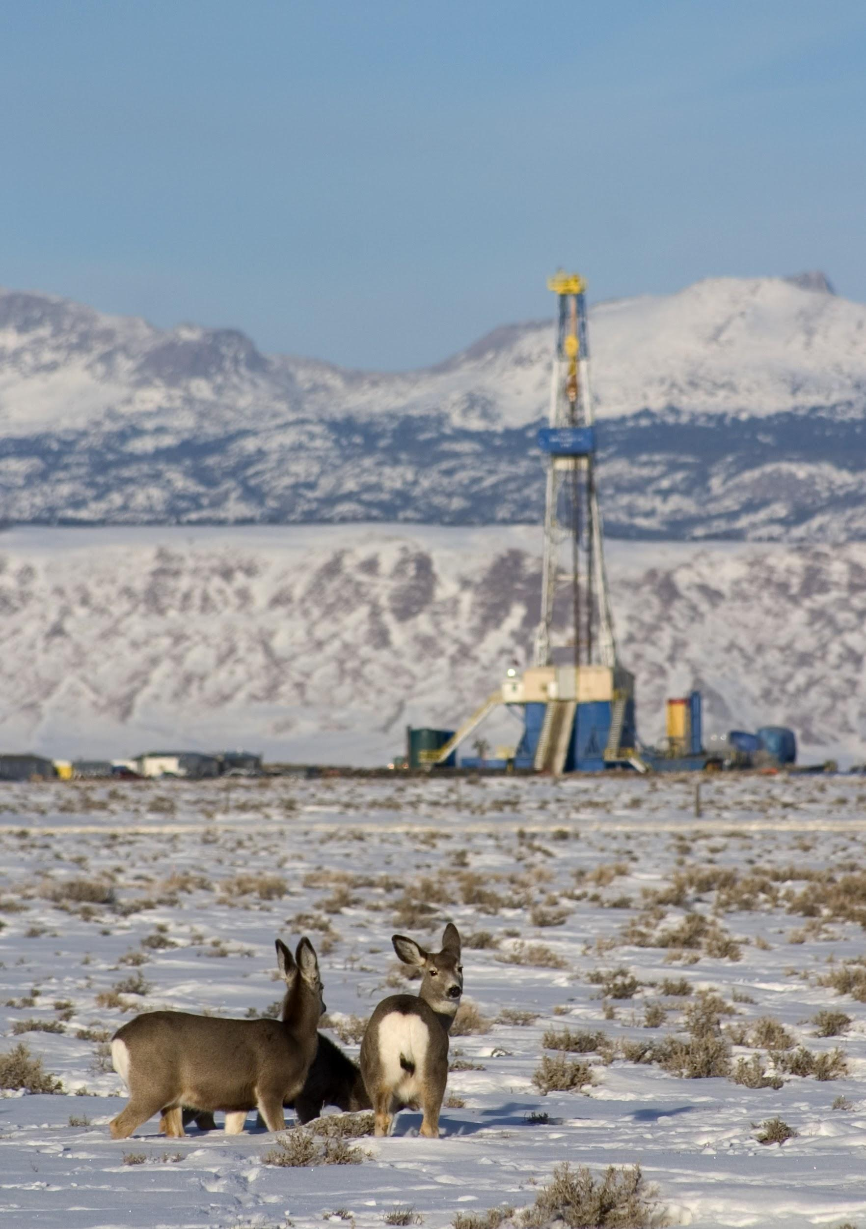
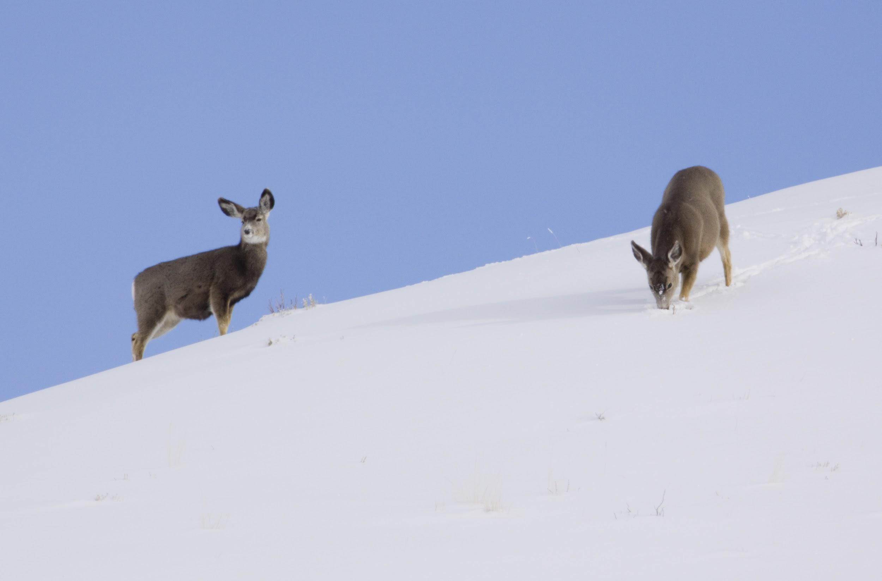

Slide 9
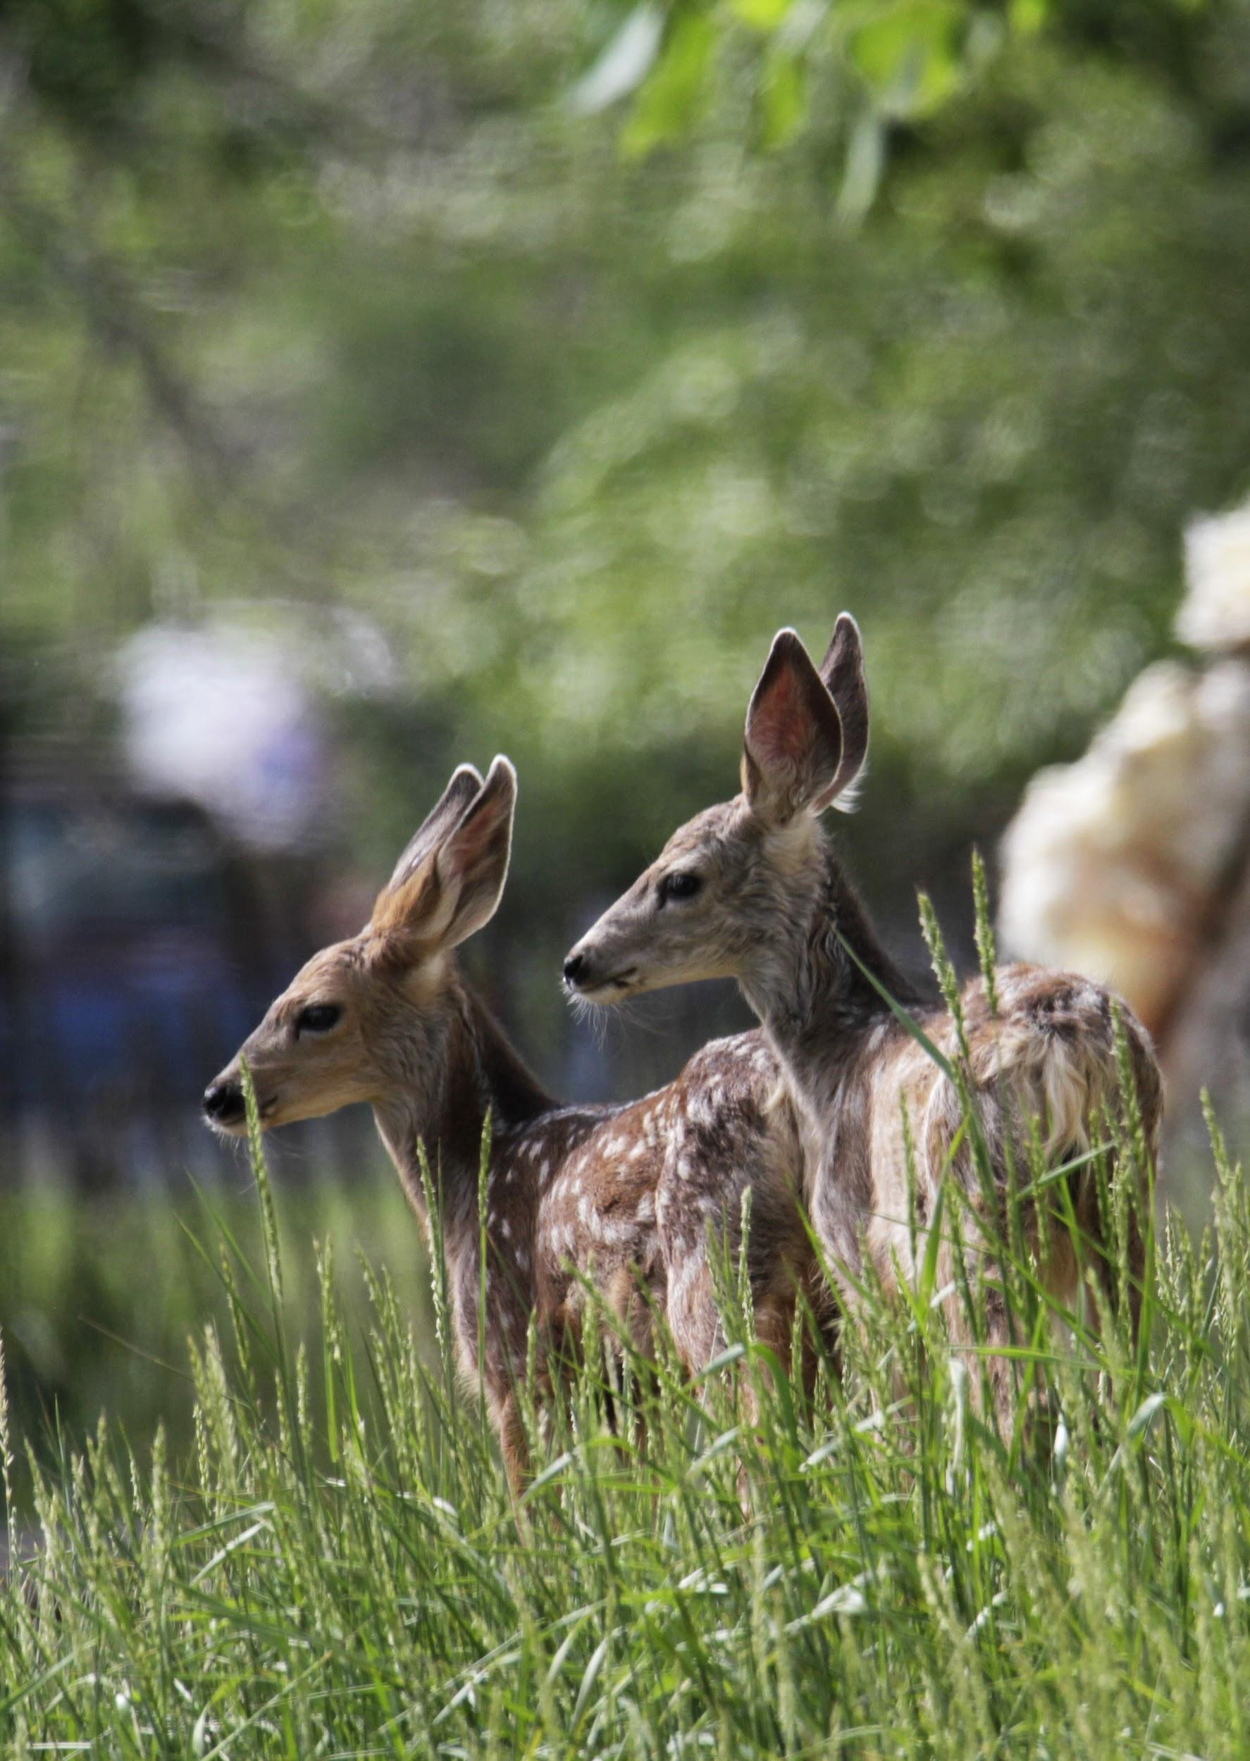
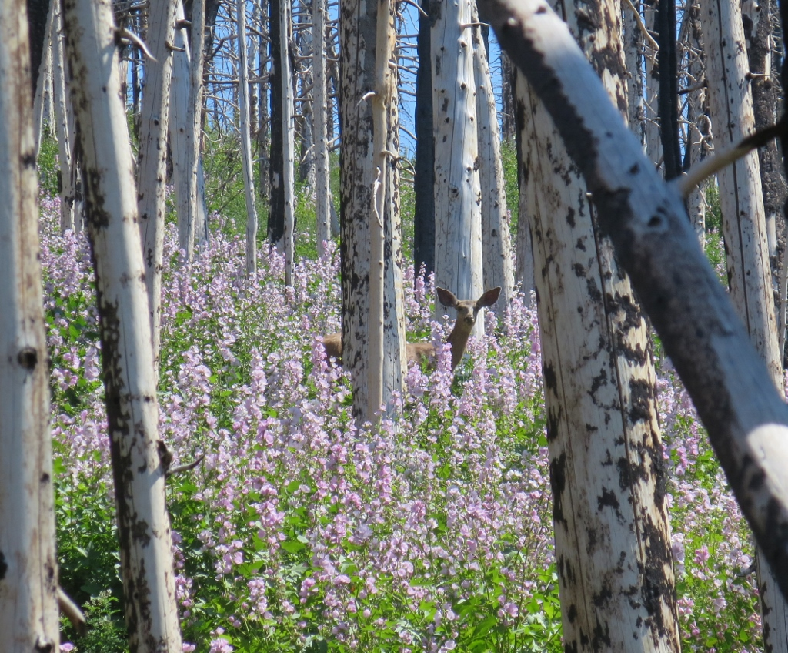

Slide 10
The public cares,
but there’s a
serious disconnect
State/
federal agencies
NGO’s/
Public

Slide 11
Encourage Collaboration
interest
awareness
involvement

Slide 13
Education on Effective Project Types
Cheatgrass Treatments
Herbicide treatments to knock back cheatgrass and other invasives before they dominate the landscape
Fence Modifications
Retool fences to wildlife friendly standards to improve movement across the landscape
Spring Exclosures
In a desert, protect limited water resources by fencing off springs to promote rejuvenation of water and vegetation
Conservation Easements
Encourage landowners to put their large tracts of land under permanent protection from development
Prescribed Fire
Burn decadent stands of sagebrush or conifers to rejuvenate understory

Slide 14
GoFundMe for Mule Deer
Online collaborative space to encourage the public and NGOs to contribute and get involved
Muley Fanatic Foundation on board as holder of contributed funds

Slide 15
Wyoming Wildlife and Roadways Initiative
2
Wyoming is a small town connected by long streets

Slide 16
Wyoming - God bless you in Wyoming. It’s very boring, and it’s the most isolated place on Earth.
RuPaul

Slide 18
If you ride into the West on a high horse, you pretty soon end up in a pile of manure
Alexandra Fuller

Slide 19
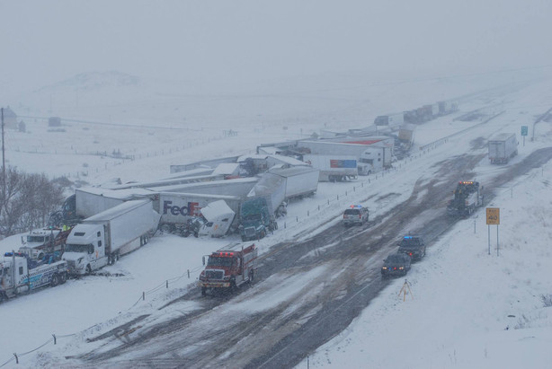
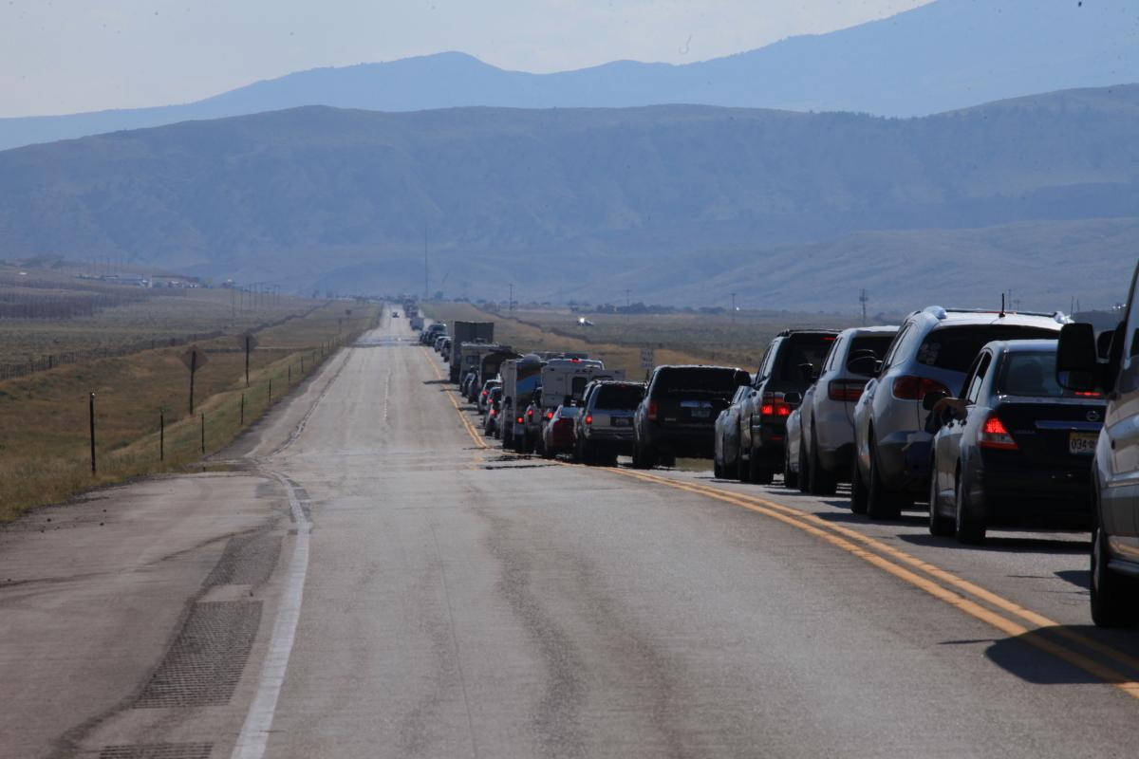

Slide 20
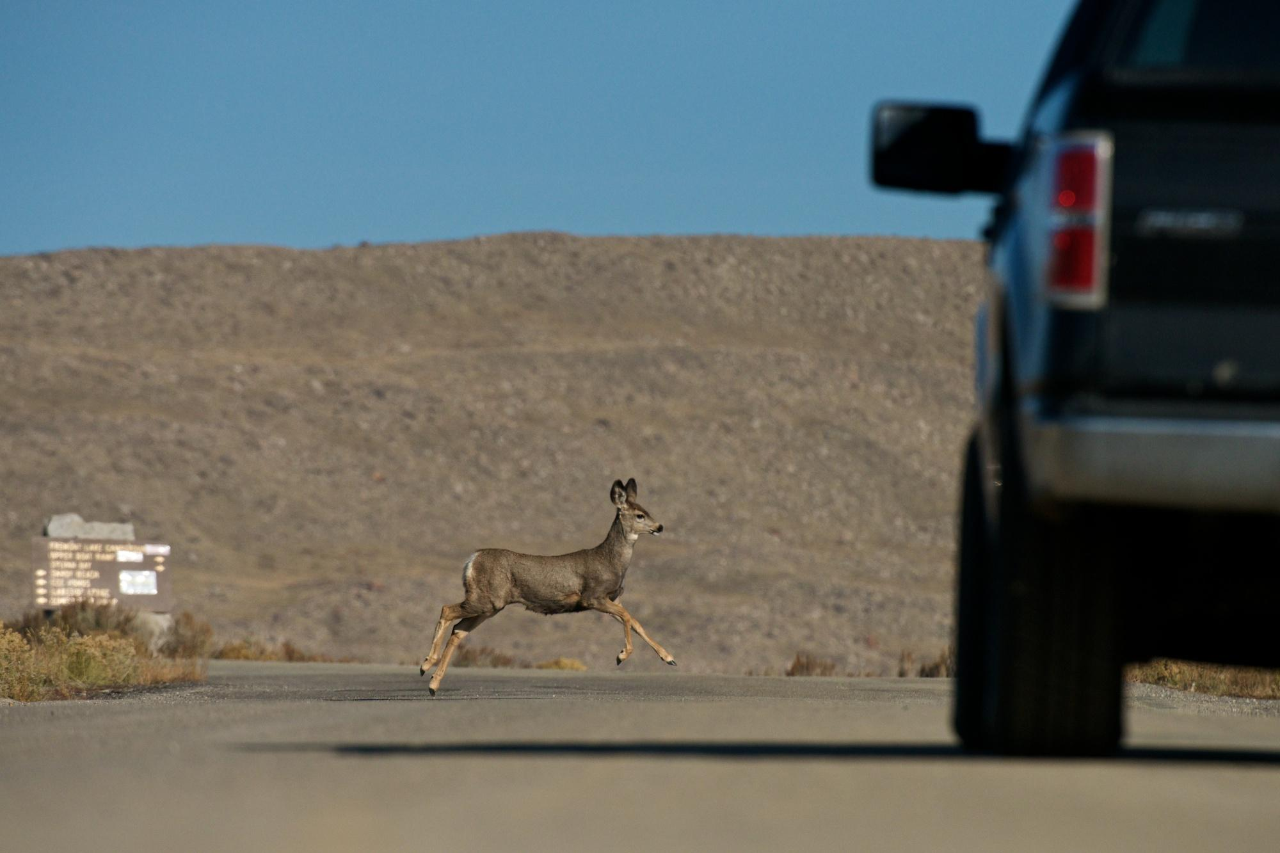
Wyoming’s Wildlife Heritage
Big game can’t read signs
Motorists don’t pay attention
Thousands of big game animals get killed each year (5,000+ mule deer alone)
Millions of dollars in property damage each year

Slide 21
$24-29,000,000
Property Damage from wildlife-vehicle collisions per year

Slide 22
$20-23,000,000
Wildlife Costs from wildlife-vehicle collisions per year

Slide 23
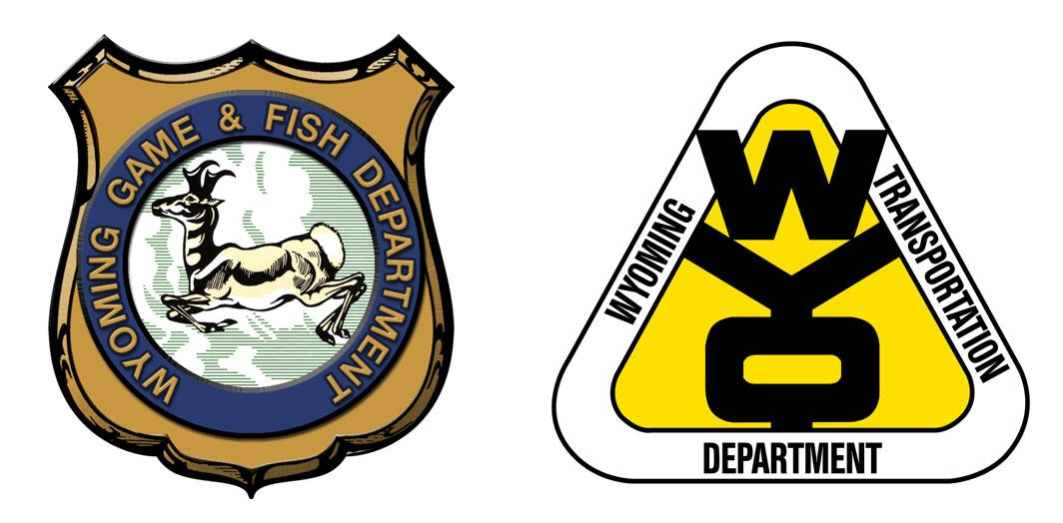
Work Together
WGFD and WYDOT collaborate to address issue

Slide 24
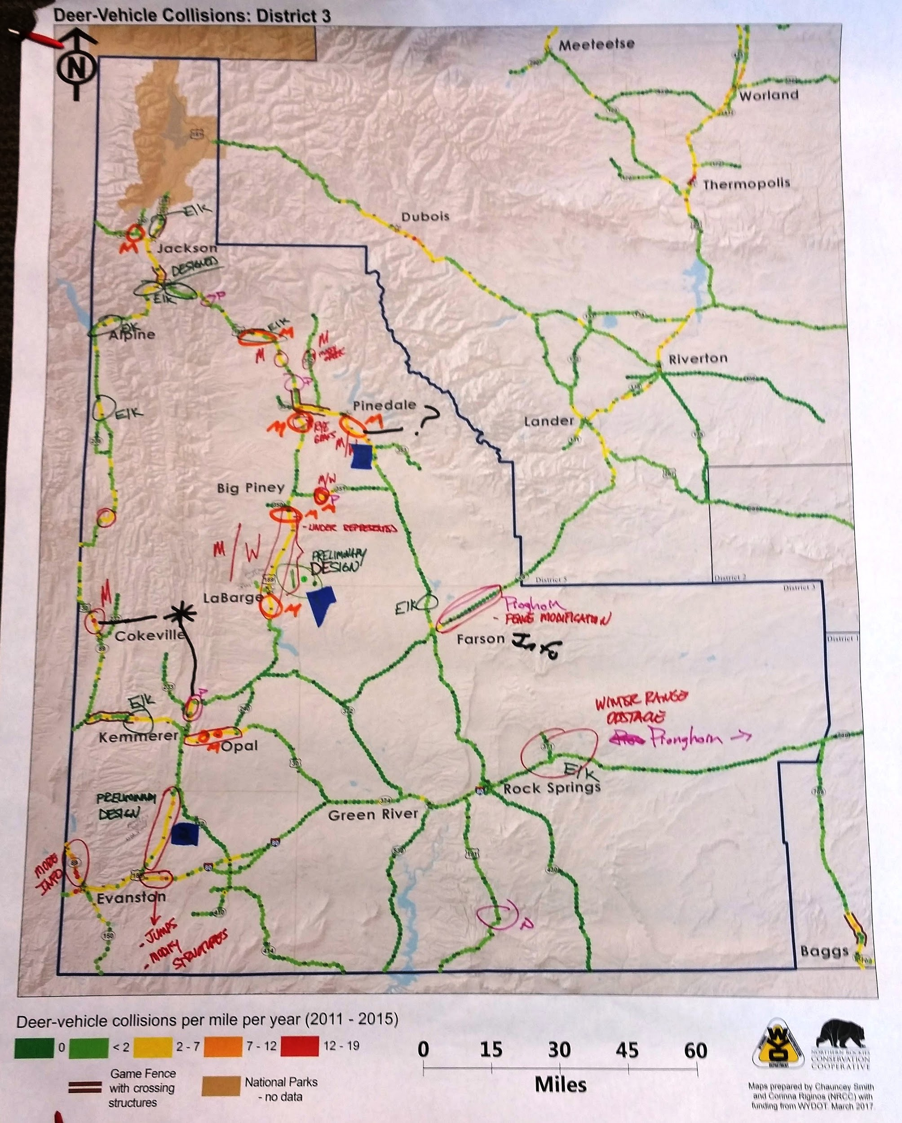
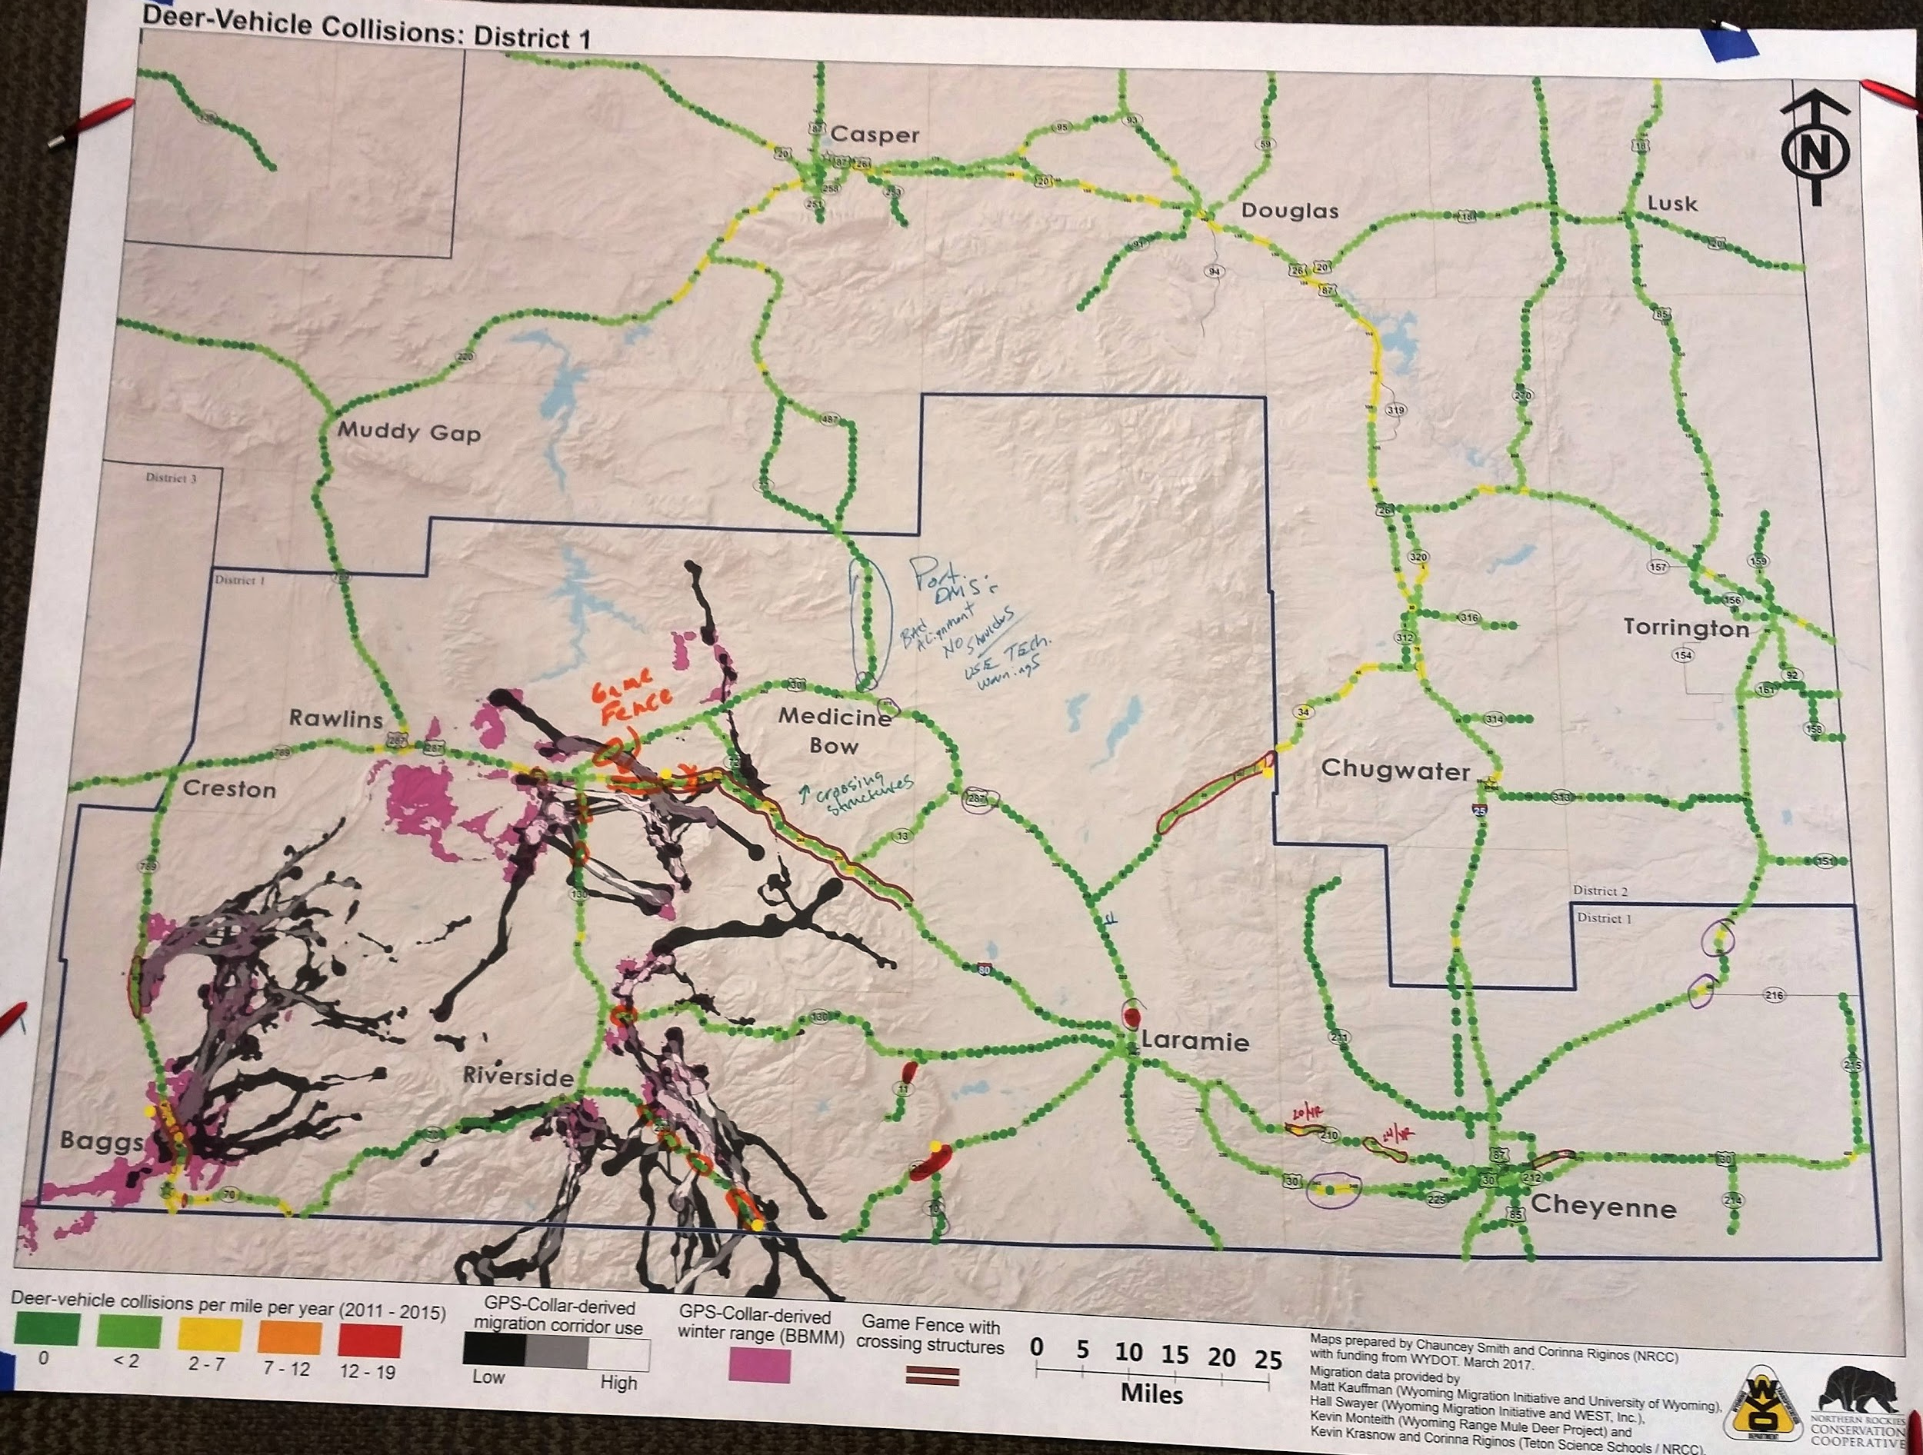
Summit 2017
State agencies
WGFD and WYDOT staff provide their professional judgement
NGOs
Reps provide their input
Interested public
Give their known problem spots

Slide 25
Summit Outcomes
Roadmap doc
Summarizing the Summit and recommendations
Wyoming Wildlife and Roadways Initiative Implementation Team
Executive team to help prioritize projects statewide and strategize implementation
Story Map
Means to communicate outcomes and share data with the public

Slide 26
WWRI Implementation Team (WWRIIT)
Categorization of project scope
Categorize into priorities
Work on collaborative funding for big projects
Develop strategy for continuous communication/feedback loop on successful projects
Identify research needs/gaps
Public education and outreach strategy

Slide 27
Story Map 2

Slide 28
Synergy

Slide 29
Thanks!
Any questions?
You can find me at:
@KarenWyGIS
Karen.rogers1@wyo.gov

